Slide 1

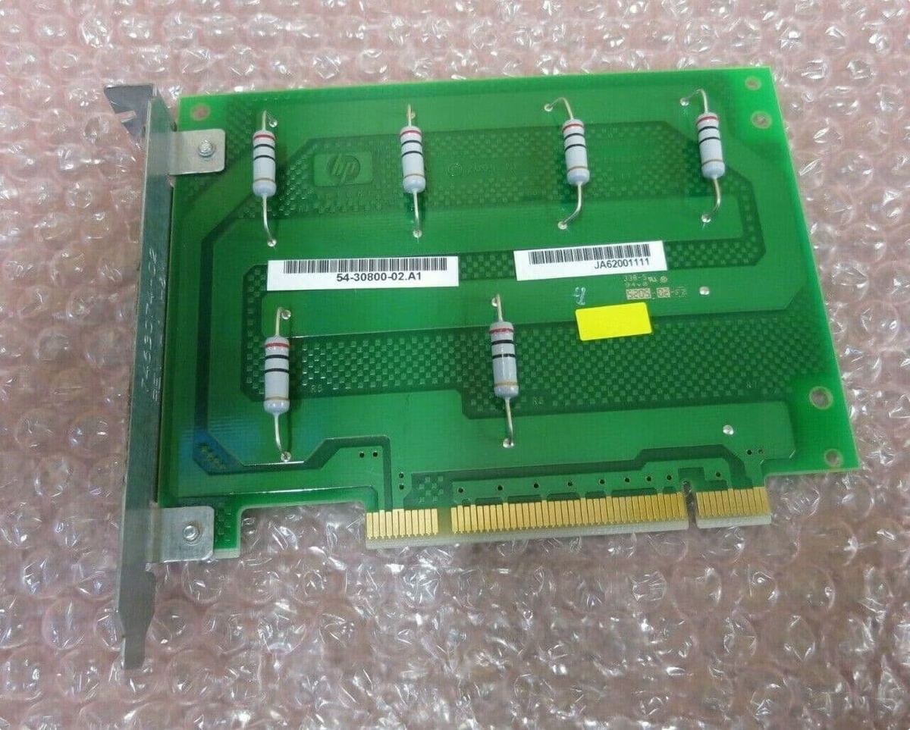
Introduction to OpenVMS and Alpha Hardware
OpenVMS is a powerful and reliable operating system that has long been paired with Alpha processors, a high-performance line of 64-bit CPUs developed by Digital Equipment Corporation. This presentation will provide an overview of the key Alpha server models supported by OpenVMS.
Rk
by Raj kishore

Slide 2
Alpha Processor Family Overview
Performance
Scalability
Reliability
Alpha processors were known for their industry-leading performance, offering exceptional speed and efficiency for demanding workloads.
The Alpha family scaled from entry-level systems to powerful enterprise-class servers, accommodating a wide range of computing needs.
With their robust architecture and advanced error-checking capabilities, Alpha systems provided the reliability required for mission-critical applications.

Slide 3

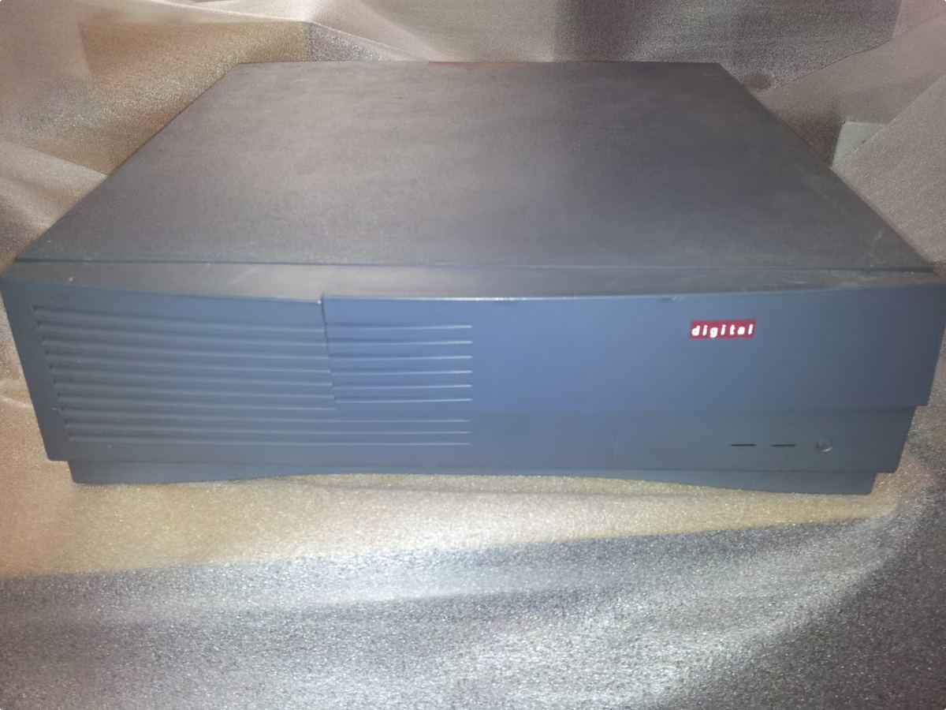
AlphaServer 4000 Series
1
Midrange Performance
2
Scalable Configuration
The AlphaServer 4000 series offered a balance of power and affordability, making it a popular choice for a variety of workloads.
These systems could be configured with up to 4 Alpha processors, providing ample compute resources as needs grew.
3
Robust Reliability
With advanced fault-tolerance features, the AlphaServer 4000 series ensured high availability for critical applications.

Slide 4

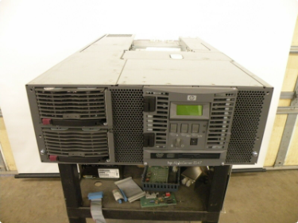
AlphaServer 8000 Series
Enterprise-Class Power
Flexible Configuration
Reliable Operation
The AlphaServer 8000 series represented the top-end of the Alpha lineup, delivering unparalleled performance and scalability.
These systems could be configured with up to 8 Alpha processors and offered extensive expansion capabilities.
The AlphaServer 8000 series was designed for mission-critical environments, with a focus on high availability and fault-tolerance.

Slide 5


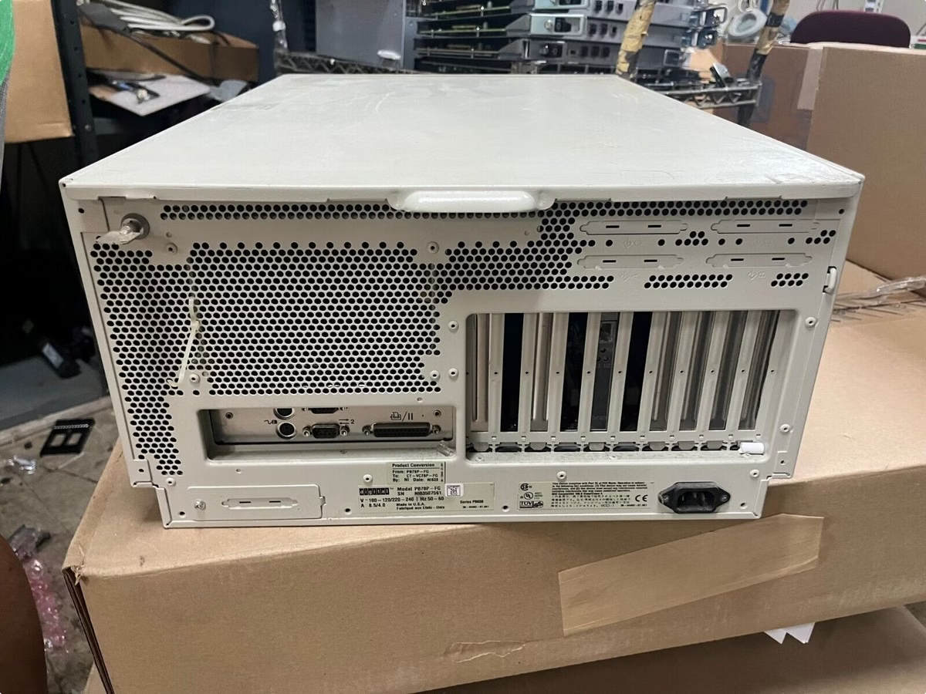


AlphaServer 1000A Series
Compact Design
The AlphaServer 1000A series offered a space-saving, tower-based form factor for smaller environments.
Balanced Performance
These systems delivered a compelling combination of processing power and cost-effectiveness.
Reliable Operation
With features like redundant power supplies, the 1000A series ensured high uptime for critical workloads.

Slide 6

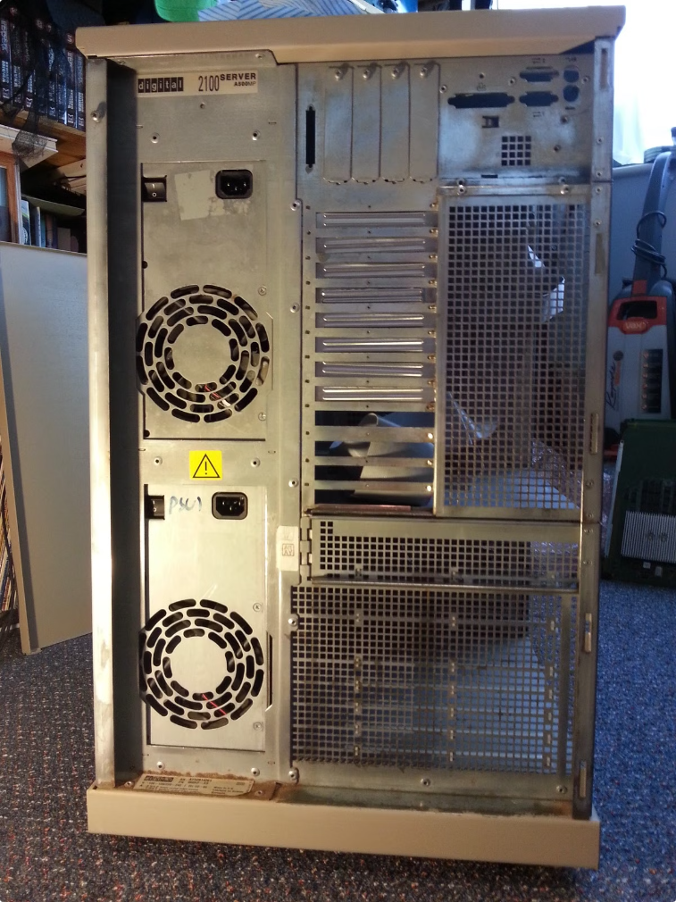
AlphaServer 2100 Series
1
Entry-Level Power
The AlphaServer 2100 series provided a solid entry point into the world of Alpha-based computing.
2
Flexible Configurations
These systems could be configured with up to 4 Alpha processors, allowing for incremental growth as needs evolved.
3
Reliable Operation
With features like hot-swappable components, the 2100 series ensured high availability for critical applications.

Slide 7

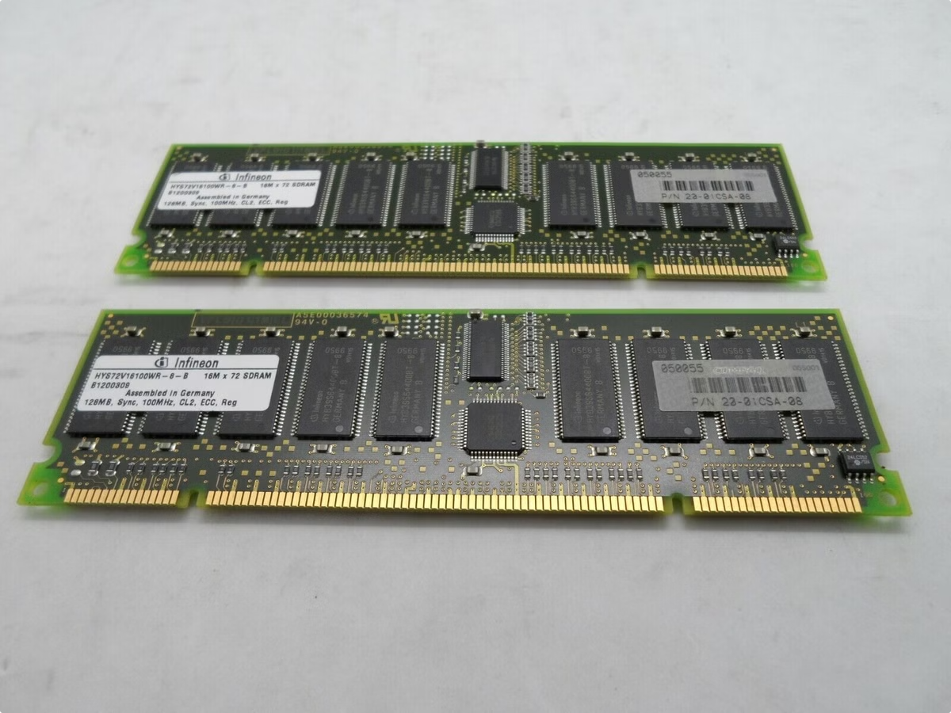
AlphaServer DS10 and DS20 Series
Model
AlphaServer DS10
AlphaServer DS20
Processors
1 or 2 Alpha CPUs
1 or 2 Alpha CPUs
Memory
Up to 4 GB
Up to 8 GB
Storage
Up to 146 GB
Up to 292 GB

Slide 8

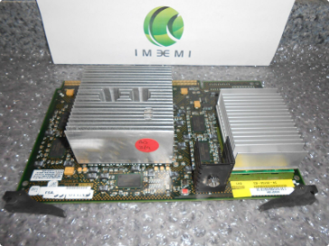



AlphaServer ES40 Series
High-End Performance
Modular Design
Robust Reliability
The AlphaServer ES40 series offered exceptional processing power and scalability for demanding enterprise workloads.
These systems featured a modular architecture, allowing for easy expansion and upgrades as requirements changed.
With advanced fault-tolerance and redundancy features, the ES40 series ensured uninterrupted operation for mission-critical applications.

Slide 9
AlphaStation 200 and 400 Series
Workstation Performance
Flexible Configuration
Reliable Productivity
The AlphaStation series provided powerful desktop computing capabilities for engineers, designers, and other professionals.
These systems could be customized with a range of Alpha processors, memory, and storage options to meet diverse needs.
With their robust design and optimized software support, the AlphaStation systems ensured reliable and efficient day-to-day operation.

Slide 10


Conclusion and Resources
In conclusion, the Alpha processor family and its associated server models provided a strong hardware foundation for the reliable and powerful OpenVMS operating system. This presentation has highlighted the key features and capabilities of the leading Alpha systems supported by OpenVMS. For more information, please consult the OpenVMS website and related resources.

